Slide 1
FAKE NEWS DETECTION USING MACHINE LEARNING
Preseted By
Mayank Singh kushwah
(0936CS20MT03)

Slide 2
Content
Indtroduction
How to News created (know about News process)
How to Identify Fake News ?
Technology for Fake News spreading
How to stop From Fake News Spreading
Conclusions

Slide 3
Indtroduction
Due to the exponential growth of information online, it is becoming impossible to explain the true from the false. Thus, this leads to the problem of fake news.
This research considers previous and current methods for fake news detection in textual formats while detailing how and why fake news exists in the first place.
This paper includes a discussion on Linguistic Cue and Network Analysis approaches, and proposes a three-part method using Naïve Bayes Classifier, Support Vector Machines, and Semantic Analysis as an accurate way to detect fake news on social media.

Slide 4
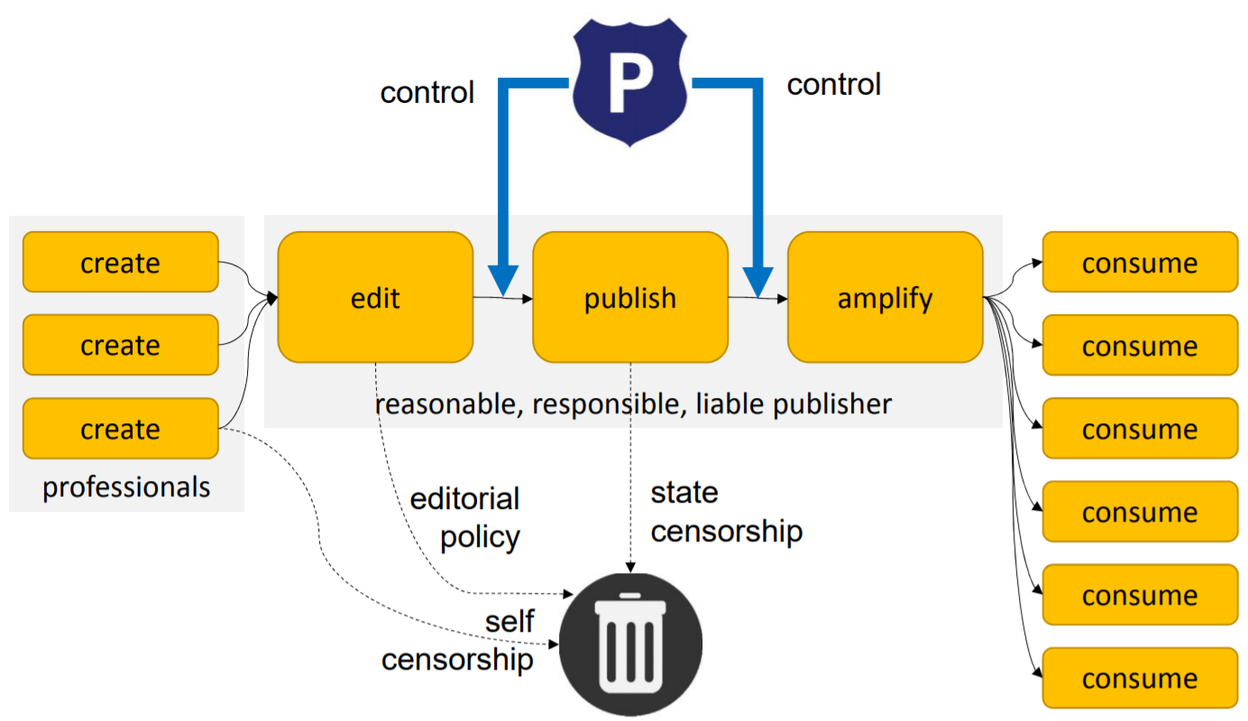
How to News created (Traditional news process)
Notes:
Traditional news process

Slide 5
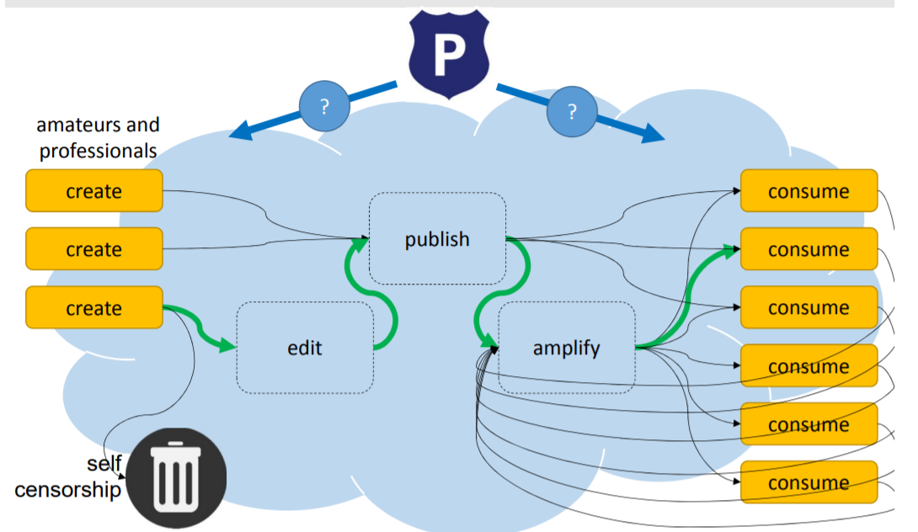
Internet-age news process
Notes:
Internet-age news process

Slide 6

Enters the Internet
Any One Can publish
Anyone can amplify
Anyone can edit
Editors are gone

Slide 7
How to Identify Fake News ?
Fake news can be identified by humans, machines or combination.
Human
Human work by fact checkers .
Fact-checking industry appearing, looking for business model.
Human-machine teamwork
machine identifies potentially fake stories .
Double-checked by human
Machine only
Artificial intelligence

Slide 8
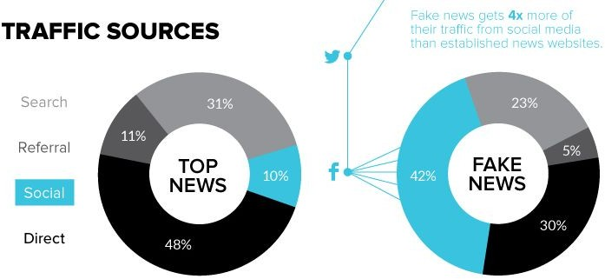
Technology for “fakenews” spreading
Social media is main driver for fakenews.
10% of readers of top news come via social media.
40% of readers of “fake news” come via social media

Slide 9
Conclusions
It is important that we have some mechanism for detecting fake news, or at the very least, an awareness that not everything we read on social media may be true, so we always need to be thinking critically. This way we can help people make more informed decisions and they will not be fooled into thinking what others want to manipulate them into believing.

Slide 10
Thank you

